Slide 1
Courtroom

Slide 2
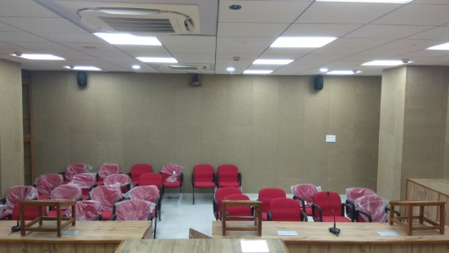
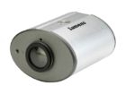
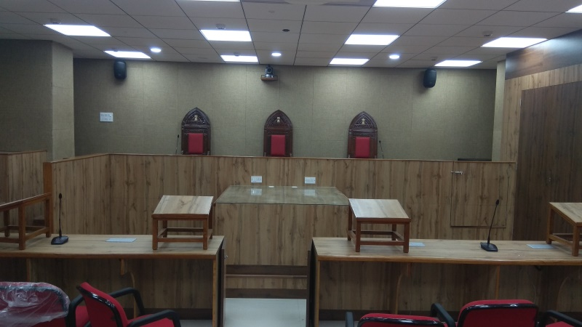
National Company Law Tribunal
India
Success Stories
Courtroom
Product: VC-A50P, VC-LC102, CL510
12 VC-A50P, 6 CL510, and 6 VC-LC102 are installed within six courtrooms for the purpose of live streaming and full HD recording of the courtroom proceedings.
One VC-A50P is placed on the back to capture Judges' view; the other VC-A50P is placed in the front to capture lawyers' view.
CL510 is placed on the ceiling to present the documents or 3D objects in real-time.
LC102 is used for recording and live streaming to the desired location through RTP or RTMP and save recordings to the server.
Lumens Ceiling Camera
CL510
Lumens PTZ Camera
VC-A50P
HDMI
Cat 5e
VGA
HDMI
Video Switcher
Display
Cat 5e
RTP/RTMP
Streaming
Cat 5e
Lumens
Lecture Capture System
VC-LC102
Network Device
FTP
NAS server
Audio
Gooseneck Microphone
Audio
Audio
Audio amplifier
Audio
Audio DSP expander
Loud Speaker
Lapel Microphone
Audio

